Slide 1
Fur Bearing Animals of Alberta

Slide 2
Beaver

Slide 3
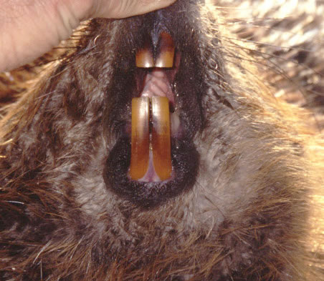

Slide 4
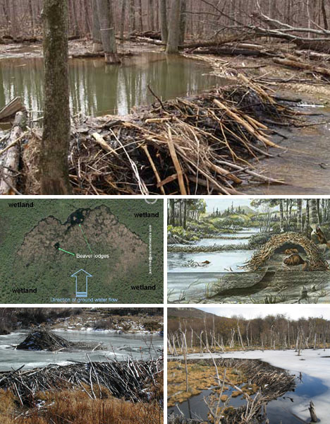

Slide 5
Muskrat

Slide 7
Marten

Slide 8
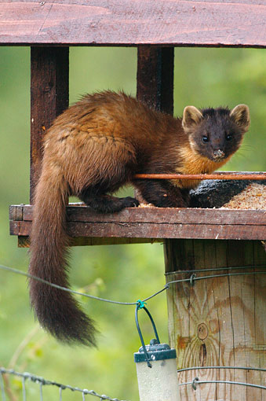

Slide 9
Fisher

Slide 10
Wolverine

Slide 11
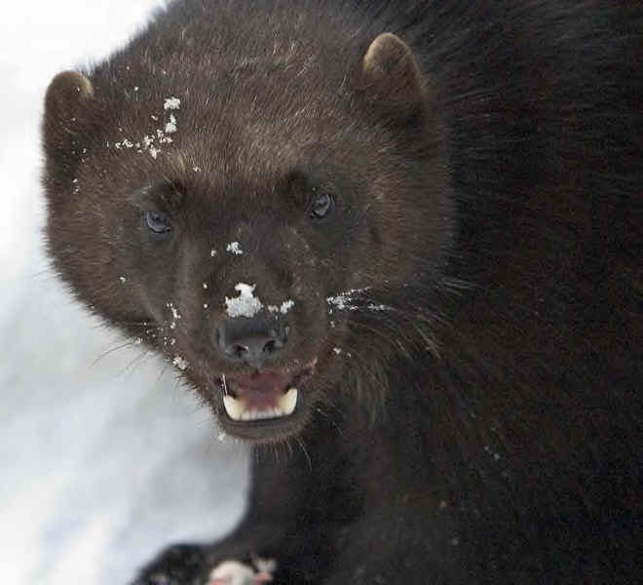

Slide 12
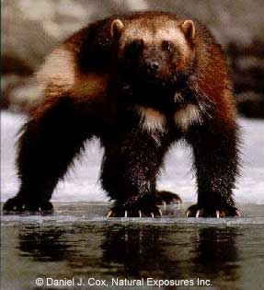
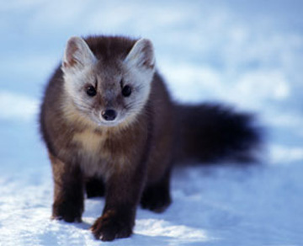
Fisher / Marten / Wolverine

Slide 13
Otter

Slide 14
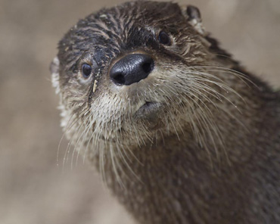

Slide 15
Mink

Slide 16
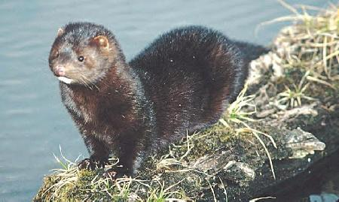

Slide 17
Squirrel

Slide 18
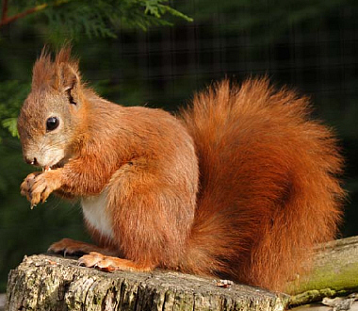

Slide 19
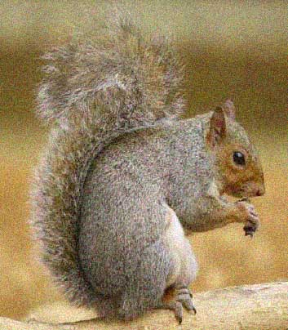

Slide 20
Badger

Slide 21
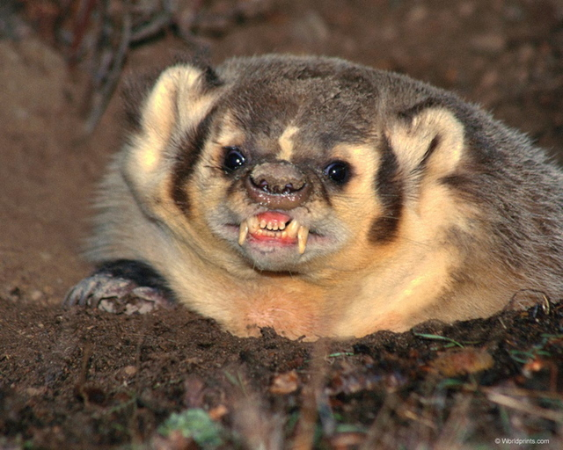

Slide 22
Bobcat

Slide 23
Lynx

Slide 24
Cougar

Slide 25
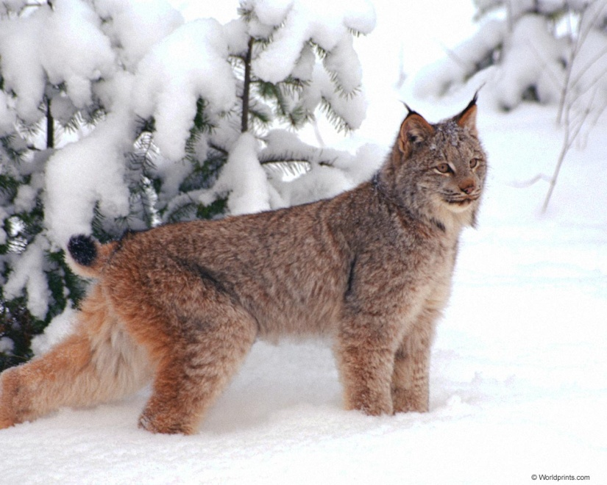
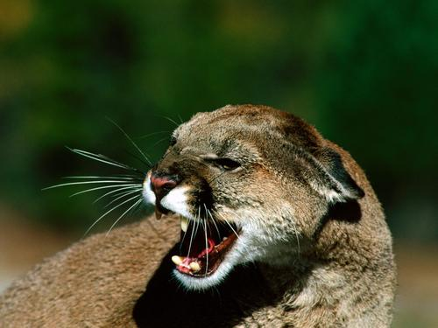
Bobcat / Lynx / Cougar

Slide 26
Coyote

Slide 27
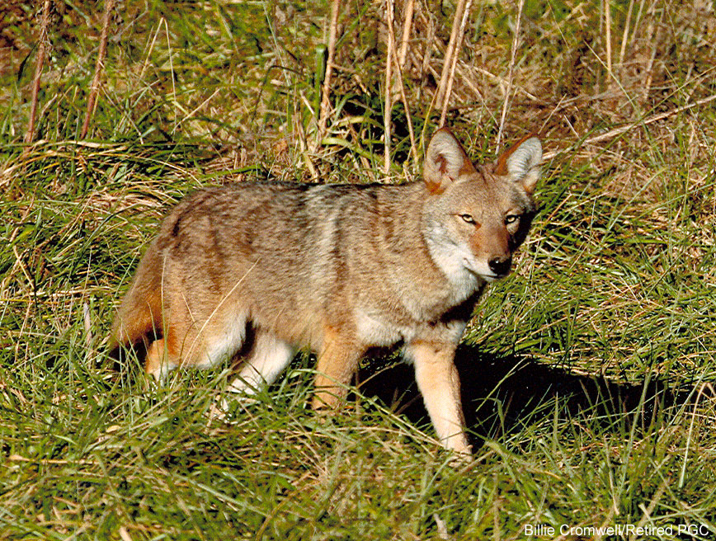

Slide 28
Wolf

Slide 29
Red Fox

Slide 30
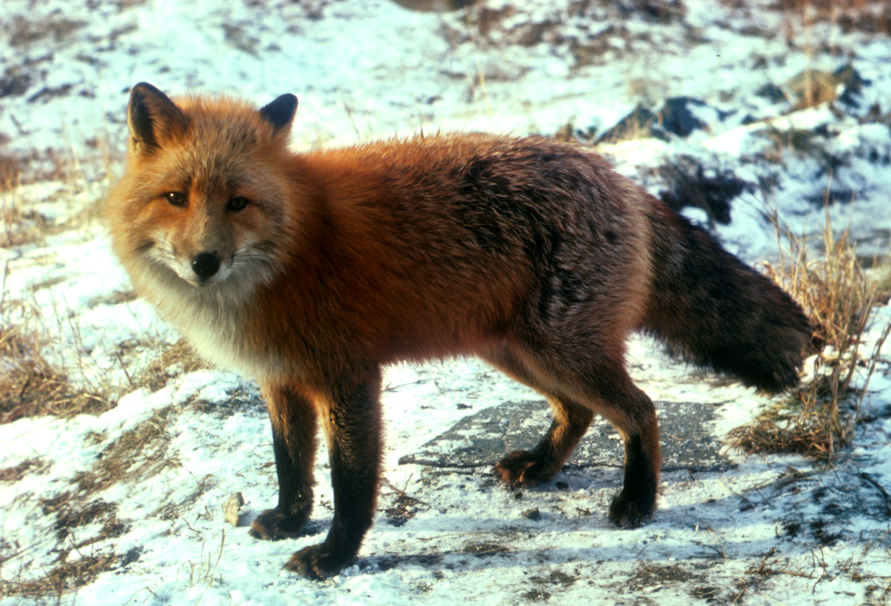

Slide 31
Cross Fox

Slide 32
Silver Fox

Slide 33
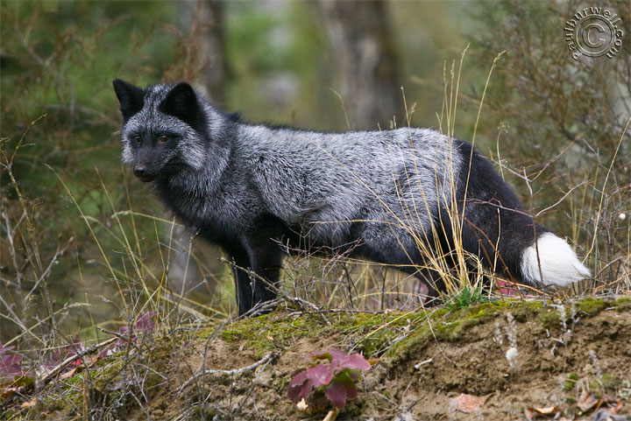
Red / Silver / Cross

Slide 34
Weasel

Slide 35
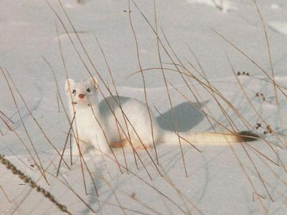
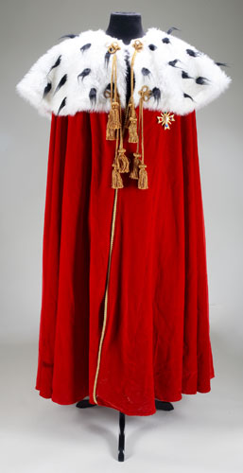

Slide 36
Skunk

Slide 37
Racoon

Slide 38
